Slide 1

Word Catcher
AKA Hangman

Slide 2
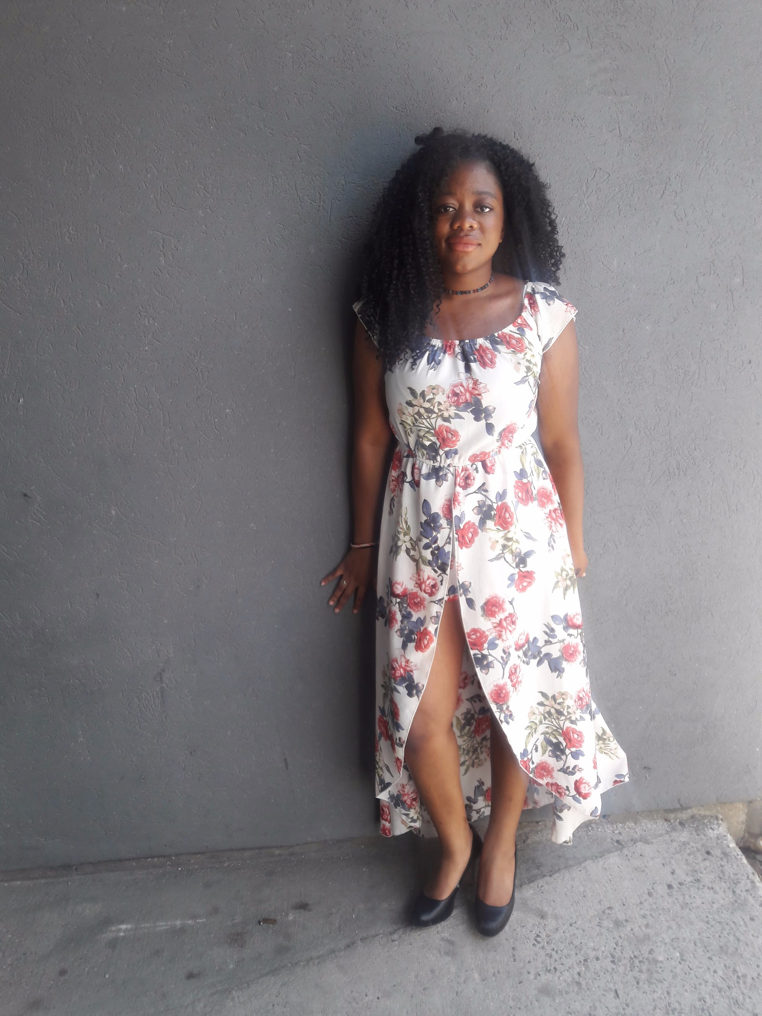
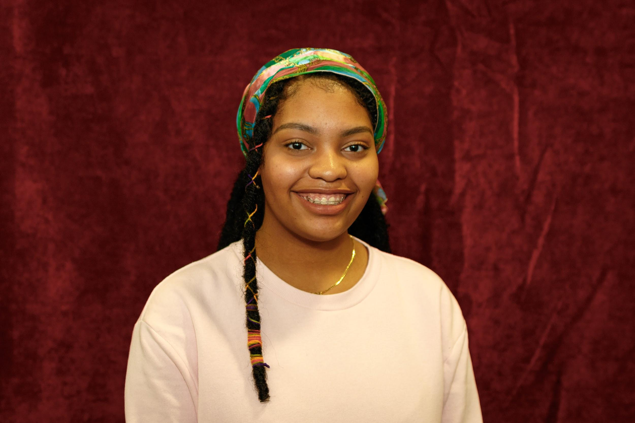
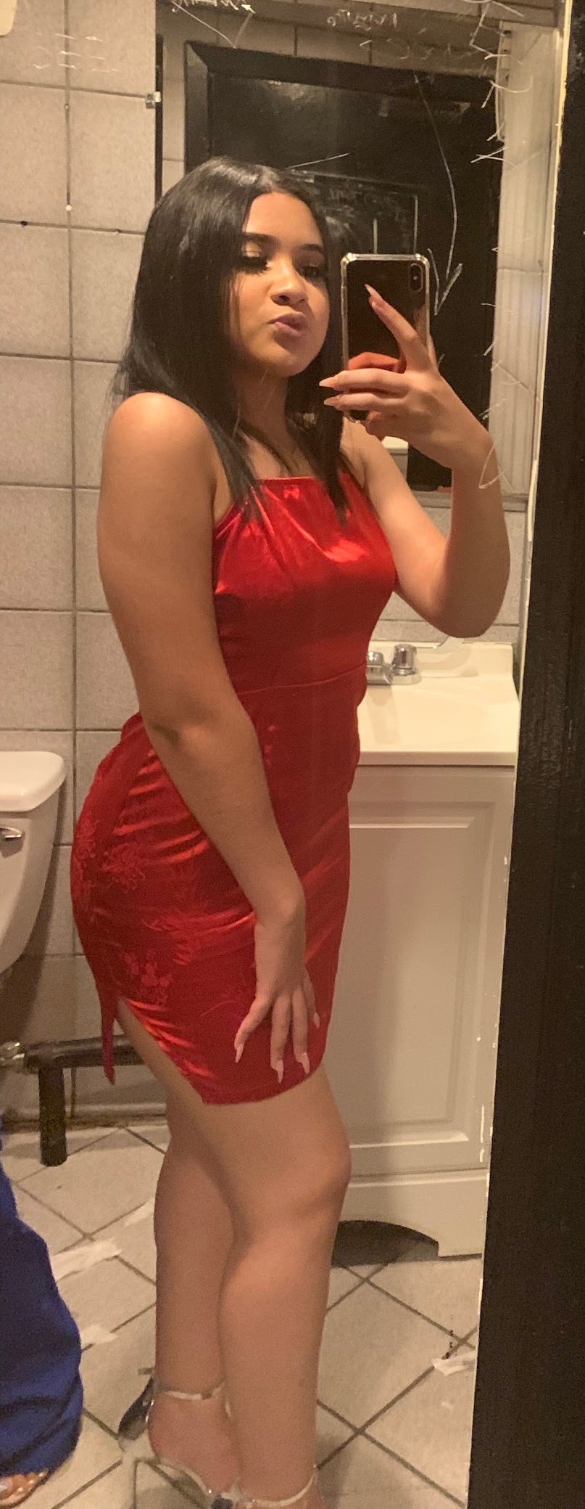
Meet the City Girls
Naomi Kalombo, Sophomore: organization and planner
Raveen, Sophomore:
Creativity and problem-solving
Mari, Freshman:
Good time-management skills, Efficient driver, patient

Slide 3

Our Game
This game consists of two-players, creating and guessing words
One player creates the word, while the second-player guesses the letters. If correct, he/she/they will receive a point (Player 1 goes first)
In the second round, the second-player creates the word and the first-player guesses. If correct he/she/they will receive a point
This will continue on for 6 rounds total
Each player has 6 chances to guess the correct word, when they guess incorrectly a part of the Hangman’s body will be drawn and they lose a chance
If one player loses, the player who creates the word will receive the point (the word will go into their word bank) and the next player goes
The computer will keep track of who is winning, who is losing, and who is up next; the player with the most words in their word bank wins

Slide 4

Why Word Catcher/Hangman?
We will be using lists, word dictionaries, and loops,
These are the topics that we have learned in class and we want to demonstrate that we understand them by implementing them in a fun game. This game also fits our majors.
This game also fits our majors. Naomi is a Linguistics major, Mari is a potential Computer Science major and Raveen is an English major. Words are interesting to us and this is a game that brings back childhood memories.

Slide 5
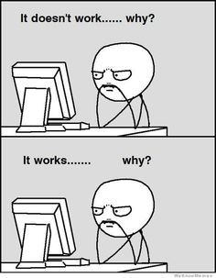
Risks
A player providing a word in a different language
Special Characters
What if somehow both players have the same number of words in their word bank?

